Slide 1
Accessing Data for Clinical Researchers:
The Boston Medical Center
Clinical Data Warehouse

Slide 2
Linda Rosen, MSEE
  Clinical Data Warehouse Research Manager
Richard Saitz, MD, MPH
  Associate Director, Office of Clinical Research

Slide 3
What is a Data Warehouse?
A data warehouse is a repository of historical data organized for reporting and analysis. It facilitates data access by having data from many sources in one place, linked together, and easily searchable.

Slide 4
What is the Clinical Data Warehouse?
In 2005, Boston Medical Center embarked on a major project to collect data spread throughout its many systems into a consolidated, organized and accessible database for analysis, reporting and research purposes.

Slide 5
CDW is
A database containing data from multiple sources
Data extracted from the databases of BMC’s Clinical software packages
A database containing data related to each other with some unique identifier
A database that is only as good as the data entered

Slide 6
Data currently available in the CDW
SDK – Registration and Visit Data
Logician – Outpatient Data
SCM – Inpatient Data
IBEX – ER Data
PICIS – Surgery Data
Tumor Registry

Slide 7
PICIS - OR
Patient demographics
Booking information
Case record data
Surgical procedure data

Slide 8
SDK - registration
Patient demographics
Patient and provider contact data
Diagnosis (ICD-9 codes)
Procedure (CPT codes) information related to a visit
Admission and discharge date/time
Visit location
Insurance information

Slide 9
Logician
Patient contact information
Appointment information (past and future)
Information entered into templates (known as observation data)
Problem list information
Referrals and tests (Orders)
Documents from pathology and radiology
Allergies and medications
Physician Notes
Flags

Slide 10
SCM – Sunrise Clinical Mgr
Patient and visit information
Lab values
Orders
Allergies

Slide 11
IBEX - ED
Admission and Discharge dates
Length of Stay
ED Location

Slide 12
Tumor Registry
Patient info
Tumor site
Date of diagnosis

Slide 13
BMC Clinical Data Warehouse
TBD
SDK
Logician
Daily
Daily
Daily
IBEX
Daily
CDW
Tumor Registry
Weekly
Weekly
PICIS
SCM

Slide 14
What kind of reports are available?
Recurring reports
One time data sets
Online reports
Data counts
Cross-referenced data
Data from a particular set of Logician templates, updated weekly

Slide 15
Examples
Demographic information for a list of MRNs
Past and future appointments for Pedi patients with referrals to a specialty clinic
Counts of patients with a diagnosis of ICD-202.10 or ICD-202.20
Data collected from a Logician template for all patients in a study

Slide 16
More Examples
Length of stay information for set of patients
Contact information for adolescents who have asthma
Count/Identify patients who are G6PD deficient
List of patients with type 2 Diabetes taking Metformin

Slide 17
Example Case I – simple counts
How many patients were admitted to the ICU in FY 2006 with ARDS (ICD-9 codes 518.5 and 518.82)?
What was the average length of stay?
What proportion of these admissions ended in death?

Slide 18
Example Case II – de-identified/anonymous data
For patients referred by a pediatrician, what is the number of missed appointments at the subspecialty clinic prior to the first kept appointment?
What is the number of rescheduled appointments prior to the first kept appointment?

Slide 19
Example Case III – identifiable data
For the provided set of medical record numbers and hospital admission dates:
  what was the value and date of the most recent WBC
  C-Reactive Protein
  Pre-albumin before the admission date?

Slide 20
Example Case IV – recurring report
For a list of Primary Care Physicians provided, find English speaking patients between 50 and 75 years-old (PCP contact info, patient contact info, insurance info, patient demographics) who have appointments in the next month, have not had a colonoscopy, fecal occult blood test, or flexible sigmoidoscopy and have no family history of colon cancer.

Slide 21
Case Study

Slide 22
How has the
Clinical Data Warehouse helped improve subject identification in our study?
Julie Glick, MPH
GI Clinical Coordinator II
Section of Gastroenterology
Department of Medicine

Slide 23
Study Overview
Principle
Investigator: Dr. Paul C. Schroy, III, MD, MPH
Design: Randomized clinical trial
Setting: BMC primary care units
Participants: Average-risk, English-speaking,
        50 to 75 years of age, previously
        unscreened, except for Fecal
        Occult Blood Test

Slide 24
Changes in Identification Strategies
Method to Identify Subjects | Dates | # Chart Audits | Hours Spent By 3 R.A.s | Subjects Enrolled
RAs Chart Audit | Mar ’05- Sept ‘05 | 1,500 | 1,440 hrs | 50
RAs Chart Audit (with MS Access db) | Sept ‘05- March ‘06 | 3,250 | 1,440 hrs | 170
Logician Reports (through Clinical Data Warehouse) | Oct ’06 - April ’07 | 3,700 | 120 hrs | 170

Slide 25
Changes in Recruitment Strategies
It is important to note that the number of subjects enrolled also increased due to changes in recruitment strategies.
PCP “clicks” in Logician + Letters from PCPs → Direct calls by RA to patients

Slide 26
Cost Analysis
Method to Identify Subjects | Cost over a 6 month period
RAs Chart Audit and Rely on PCP for Recruitment | $ 1,300 (Clicks) + $25,700 (Letters) $27,000
RAs Chart Audit (with MS Access) and Make Direct Calls | $23,300
Logician Reports (from CDW) With Direct Calls | $11,800 – $ 3,000 (Initial start cost) $ 8,800 (going forward)

Slide 27
Tweaking the Reports
Since July ’06, we have worked with Linda and the CDW to identify patients that are appropriate and eligible for our study.
The majority of our work was done in the first few months, but it has been an ongoing process.
Medical records contain detailed information and providers document patient information in different places in the Logician charts. Therefore, we continue to provide feedback to Linda to enable her to improve our reports.

Slide 28
Conclusion
During the months that Linda has been working with us, we have saved time and reduced our costs significantly.
We now have more time to spend on recruiting and meeting with subjects, as well as working on other studies.
We are currently writing a paper on the importance of utilizing medical record technology to improve patient identification and recruitment.

Slide 29
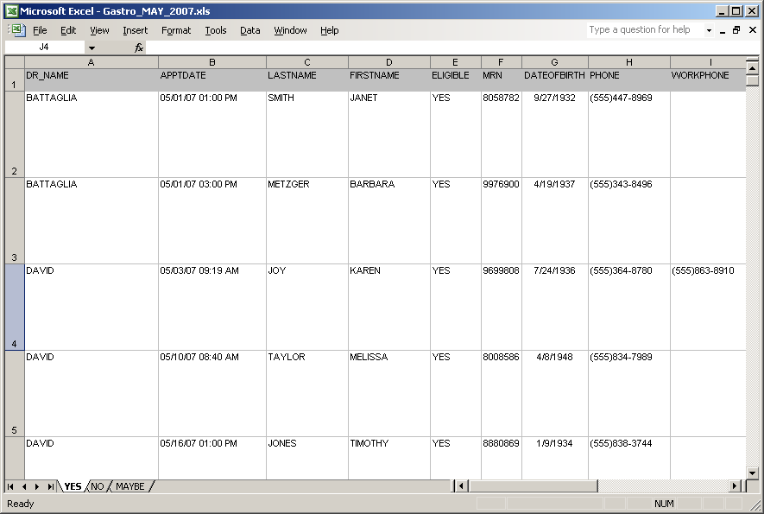
Recurring Report Example

Slide 30
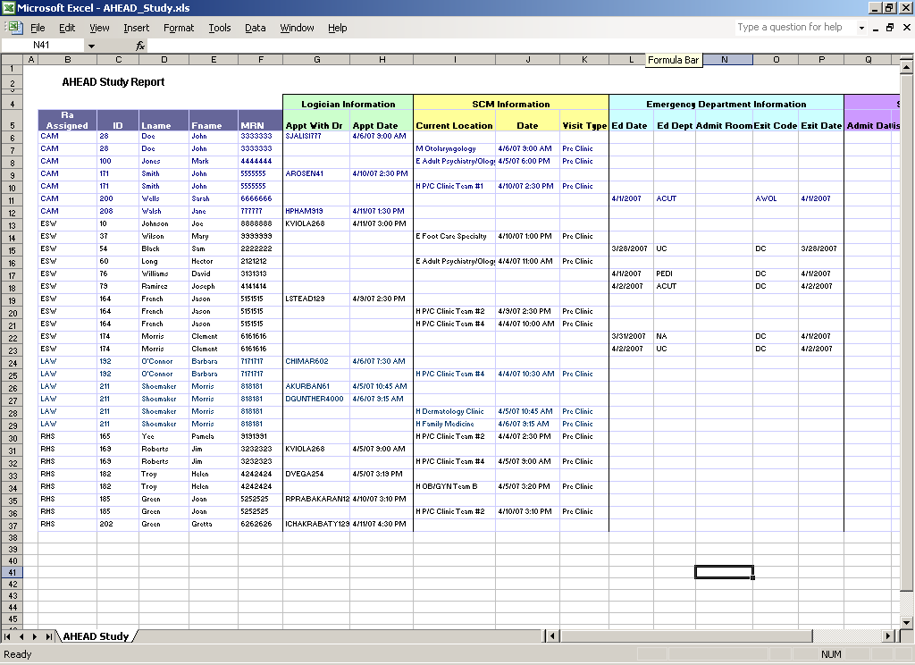

Slide 31
Applying to Use the data in the Clinical Data Warehouse
Am I doing human subjects research?
Do I need to have data that identifies patients?
Will I need to return to find additional information after a data set is created?
Does my data request restrict a count to a very small number?

Slide 32
Regulatory Issues
Same as for accessing other databases, individual paper records or electronic files
Researchers covered by BUMC
HIPPA form for counts
IRB Approval for anything other than counts

Slide 33
CDW and the IRB
All CDW requests except for some of those asking for simple counts require submission of a proposal for review to the IRB.
If the project is human subjects research, then it must be approved by the IRB.

Slide 34
Data Counts:
Preparatory to Research Form only, no IRB needed
  Submit Prep to Research form to Linda Rosen

Slide 35
Anonymous Data:
IRB exempt application and relevant HIPAA forms

Slide 36
Identifiable Data:
IRB Expedited/Full Board Application and relevant HIPAA forms

Slide 37
Preparatory to Research

Slide 38


Principal Investigator:
Email address:
Phone number:
Research Staff needing access to protected health information:
As approved by IRB in INSPIR Section A
[Investigator to change if different from INSPIR Section A]
Study Title or Study Idea:
Number of records needed: > 50 < 50
The Privacy Rule (45 CFR 164.512) allows the use or disclosure of protected health information required in order to prepare a research application or proposal, provided that certain criteria are met. Please read the following statements. If you agree, please sign below. Also complete item #4.

Slide 39
The use or disclosure requested will be limited to the preparation of a research protocol or for similar purposes preparatory to research.
No protected health information will be removed from the covered entity by the researcher in the course of the review.
The requested information constitutes the minimum necessary data to accomplish the goals of the research.
Please attach a list of the selection criteria for records required (e.g.; all asthmatics seen in the Asthma Clinic), the dates of the records required (e.g.; clinic visits from July 1, 1998 through December 31 2000), and data fields required for the research.
By submitting this form with an INSPIR application, the PI attests to the following:
I declare that the requested information constitutes the minimum necessary data to accomplish the goals of the research.
I agree that the protected health information will not be re-used or disclosed to any other person or entity, except as required by law, for the authorized oversight of the research study, or for other research for which the use or disclosure of protected health information would be permitted by the Privacy Regulation (45 CFR 164.512)

Slide 40
DATA AND/OR RECORDS NEEDED FOR RESEARCH PROTOCOL
Selection Criteria (e.g.; asthmatics seen is Asthma Clinic)
Dates of required records: from ___/___/___ through ___/___/___
Data fields required (list fields required from an electronic data base)
Anticipated sources of information (check all that apply)
Paper medical records
Electronic files
Other ________________

Slide 41
How do researchers access the CDW?
Through the Clinical Data Warehouse Research Manager
  http://www.bumc.bu.edu/ocr/dataaccess
  Contact Linda Rosen at LiRosen@bu.edu

Slide 42
A simple query:
SELECT count(distinct(mrn)) FROM sk_visit
WHERE to_date(visit_date, ‘mm/dd/rr’)
BETWEEN TO_DATE(’01/01/05’, ‘mm/dd/rr’)
AND TO_DATE(’12/31/05’, ‘mm/dd/rr’)
AND (visit_type = ‘E’
OR admit_source = ‘EMERGENCY ROOM’);

Slide 43
Database relationship

Slide 44
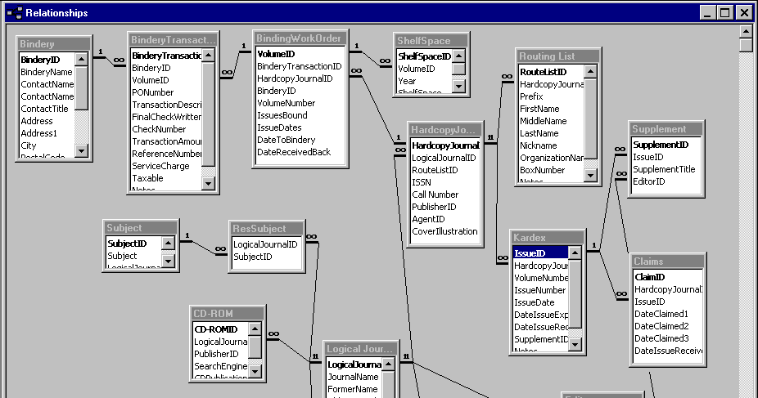
Database Relationship Diagram

Slide 45
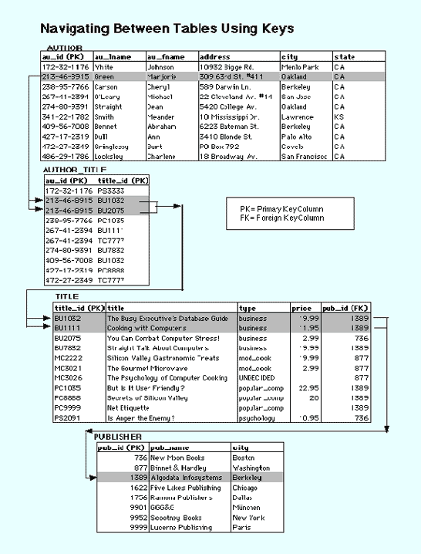

Slide 46
Accessing Data in the Clinical Data Warehouse …..
Assess your data needs
Submit the appropriate IRB form(s)
Plan for data access in your grant application budget
Plan a meeting with Linda Rosen

Slide 47
Questions

